Slide 1
NEWTON-RAPHSON METHODOLOGY FOR MODFLOW

Slide 2
General Issues with MODFLOW
Originally developed for groundwater flow problems with standard boundary conditions to solve linear (confined) to well-behaved non-linear (unconfined) problems.
Empirical wetting and drying approach added by McDonald and others (1992) to allow cell conversion to simulate more difficult unconfined problems.
Three-dimensional unconfined applications and head-dependent stress packages can create additional nonlinearities.

Slide 3
Wet/Dry Nonlinearities
Standard MODFLOW deals with wet/dry problem by removing dry cells. This creates discontinuities and oscillations.
Solution:
Keep all cells active even when they are dry

Slide 4
Problem #1 – keeping cells active
Consider two adjacent cells one dry and one partially wet
dry
H=100
H=95
wet
Standard intercell conductance averaging based on saturated thickness will cause water to flow from a dry cell to a wet one.

Slide 5
Solution #1 – upstream weighting
dry
h_{up}=100
BOT_{up} = 100
h=95
wet
Conductance is calculated based on saturated thickness of cell with higher head only. Thus, flow will not leave a dry cell

Slide 6
Problem #2 – conductance
Conductance transitions from head-dependent to constant
0
Cell
bottom
Cell
top
Transition causes to change from 1 to zero, a discontinuous derivative

Slide 7
Solution #2 – smoothing
Smooth Saturated Thickness Function over the Discontinuity

Slide 8
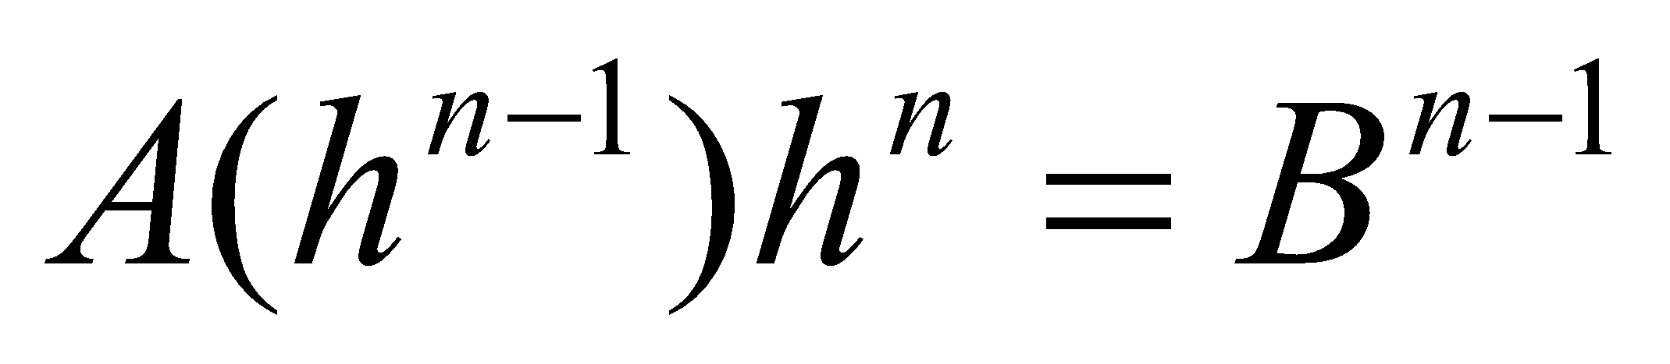
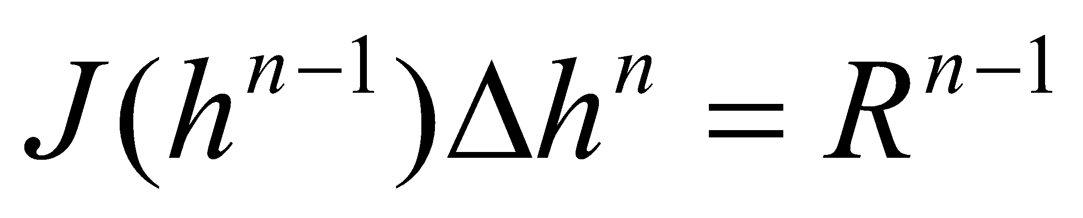
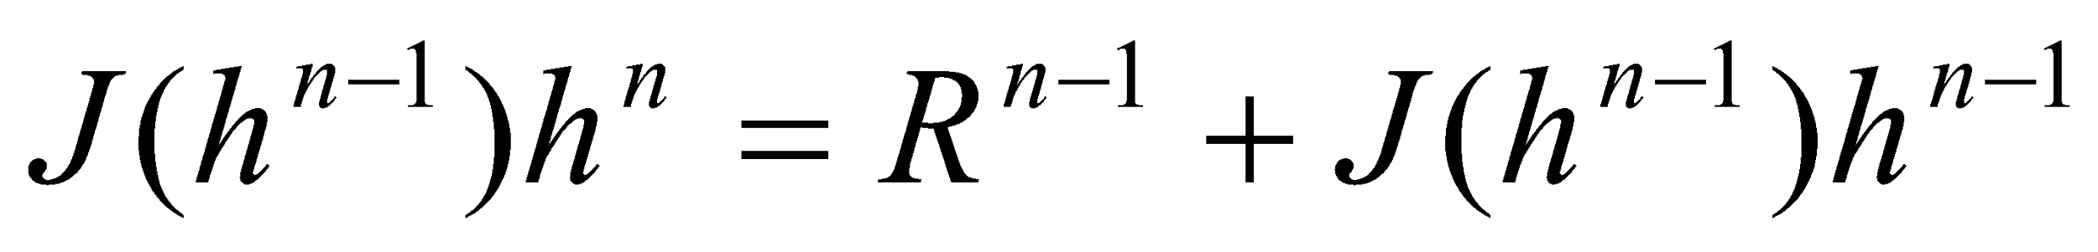
Linear equations
Conductance:
Newton-Raphson:
Modified
Newton-Raphson:

Slide 9
Newton-Raphson
BEGIN Options
LIST uzfp3_lakmvr_v2.lst
NEWTON UNDER_RELAXATION
END Options
BEGIN Packages
DIS6 uzfp3_lakmvr_v2.dis
IC6 uzfp3_lakmvr_v2.ic
NPF6 uzfp3_lakmvr_v2.npf
STO6 uzfp3_lakmvr_v2.sto
OC6 uzfp3_lakmvr_v2.oc
SFR6 uzfp3_lakmvr_v2.sfr 'SFR_1'
LAK6 uzfp3_lakmvr_v2.lak 'LAK_1'
GHB6 uzfp3_lakmvr_v2.ghb
UZF6 uzfp3_lakmvr_v2.uzf 'UZF_1'
MVR6 uzfp3_lakmvr_v2.mvr
OBS6 uzfp3_lakmvr_v2_head.obs
END Packages

Slide 10
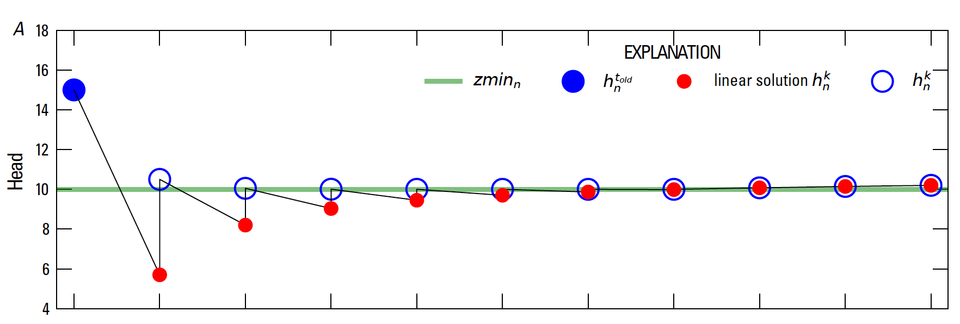
Newton Under-Relaxation

Slide 11
Newton Raphson
Once Newton-Raphson is enabled in the name file Newton-Raphson is also used for GWF terms formulated by
Storage Package
Well Package (auto flow reduce)
Lake Package*
Multi-aquifer Well Package
Streamflow Routing Package*
Unsaturated Zone Flow Package*
* Stress package continuity equation also solved using Newton-Raphson

Slide 12
Newton-Raphson Formulation
Newton-Raphson formulation is more robust than Picard for strongly non-linear problems.
Newton-Raphson formulation results in a asymmetric matrix.
Asymmetric matrix requires different linear accelerators, line search methods, and under-relaxation methods

Slide 13
Iterative Model Solution (IMS6) Package
Nonlinear methods
Backtracking
Under-relaxation Methods
Simple (like PCG under-relaxation)
Cooley
Delta-Bar-Delta
Pseudo-Transient Continuation for steady-state Newton-Raphson problems

Slide 14
Iterative Model Solution (IMS8) Package
Linear methods
Linear accelerators
Conjugate Gradient
Bi-Conjugate Gradient Stabilized
ILU Factorization preconditioners
Row sum agreement
Level-fill
Drop-tolerance
RCM and Minimum Degree reordering

Slide 15
IMS8 Input
BEGIN OPTIONS
PRINT_OPTION ALL
CSV_OUTPUT FILEOUT NWTP3LOW.IMS.CSV
END OPTIONS
BEGIN NONLINEAR
OUTER_HCLOSE 1.E-3
OUTER_MAXIMUM 1500
UNDER_RELAXATION DBD
UNDER_RELAXATION_THETA 0.90
UNDER_RELAXATION_KAPPA 0.
UNDER_RELAXATION_GAMMA 0.
UNDER_RELAXATION_MOMENTUM 0.
BACKTRACKING_NUMBER 20
BACKTRACKING_TOLERANCE 2.
BACKTRACKING_REDUCTION_FACTOR 0.6
BACKTRACKING_RESIDUAL_LIMIT 1.0
END NONLINEAR
BEGIN LINEAR
INNER_MAXIMUM 200
INNER_HCLOSE 1.0E-6
INNER_RCLOSE .0 RELATIVE_RCLOSE
LINEAR_ACCELERATION BICGSTAB
REORDERING_METHOD NONE
PRECONDITIONER_LEVELS 5
NUMBER_ORTHOGONALIZATIONS 7
PRECONDITIONER_DROP_TOLERANCE 1.0E-4
END LINEAR

Slide 16
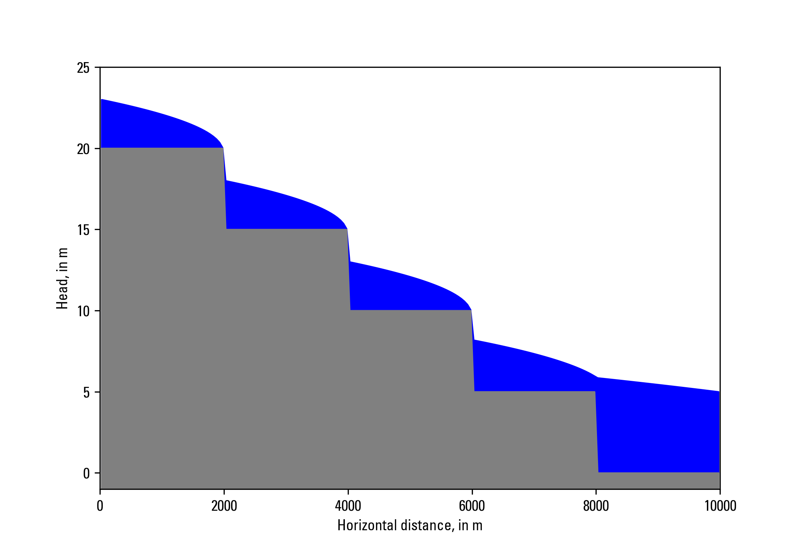
Newton Raphson
Zaidel, Jacob, 2013, Discontinuous steady-state analytical solutions of the Boussinesq equation and their numerical representation by MODFLOW: Groundwater, v. 51, p. 952–959. doi: 10.1111/gwat.12019.

Slide 17
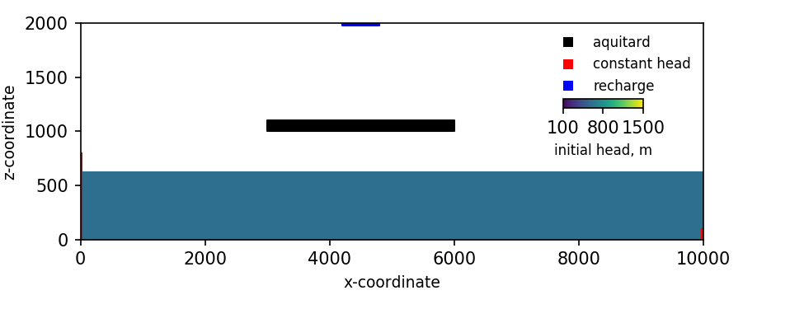
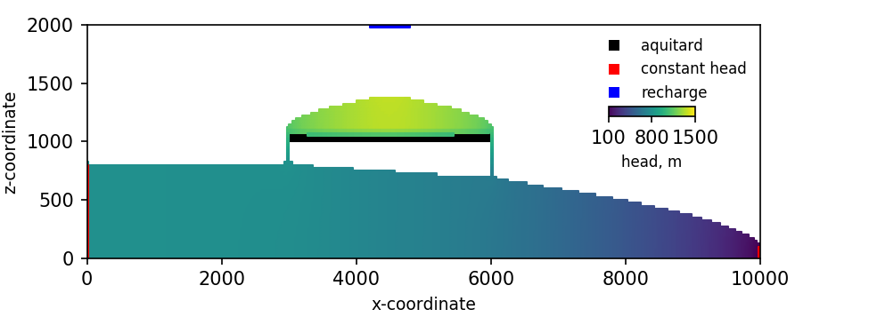
Newton Raphson
Keating, Elizabeth, and Zyvoloski, George, 2009, A stable and efficient numerical algorithm for unconfined aquifer analysis: Ground Water, v. 47, no. 4, p. 569–579, accessed June 27, 2017, at https://doi.org/10.1111/ j.1745-6584.2009.00555.x.

Slide 18
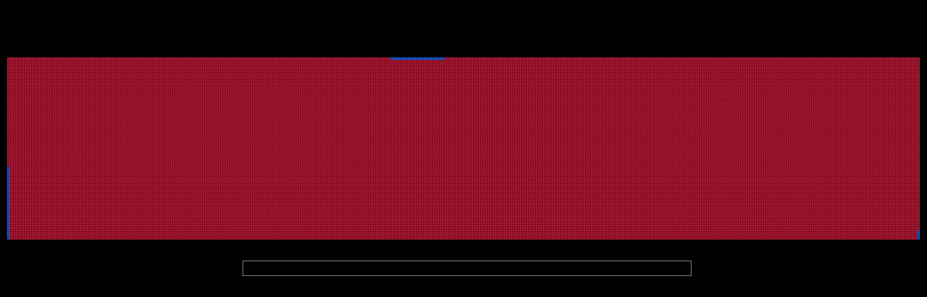
Newton Raphson

